Slide 1
Rapid Risk Assessment
Epi 224. Health and Ecological Risk Analysis, Spring 2022
Instructor: Jose Pablo Gomez-Vazquez
Email: jpgo@ucdavis.edu
Website: http://spablo-temporal.network/

Slide 2
Outline
Introduction to RRA
Why RRA?
How to? (RRA steps)
Introduction to R studio
QuantRRA

Slide 3
Introduction
Risk analysis
Hazard identification
Risk assessment
Risk management
Risk communication
OIE 2021
Notes:
I am sure that all of you are very familiarized with this image, in the overall activity of Risk analysis, we describe 4 main components that include: …
Rapid risk assessment is no different, but its aimed to answer questions in emergency situations when limited time, information and resources are available

Slide 4


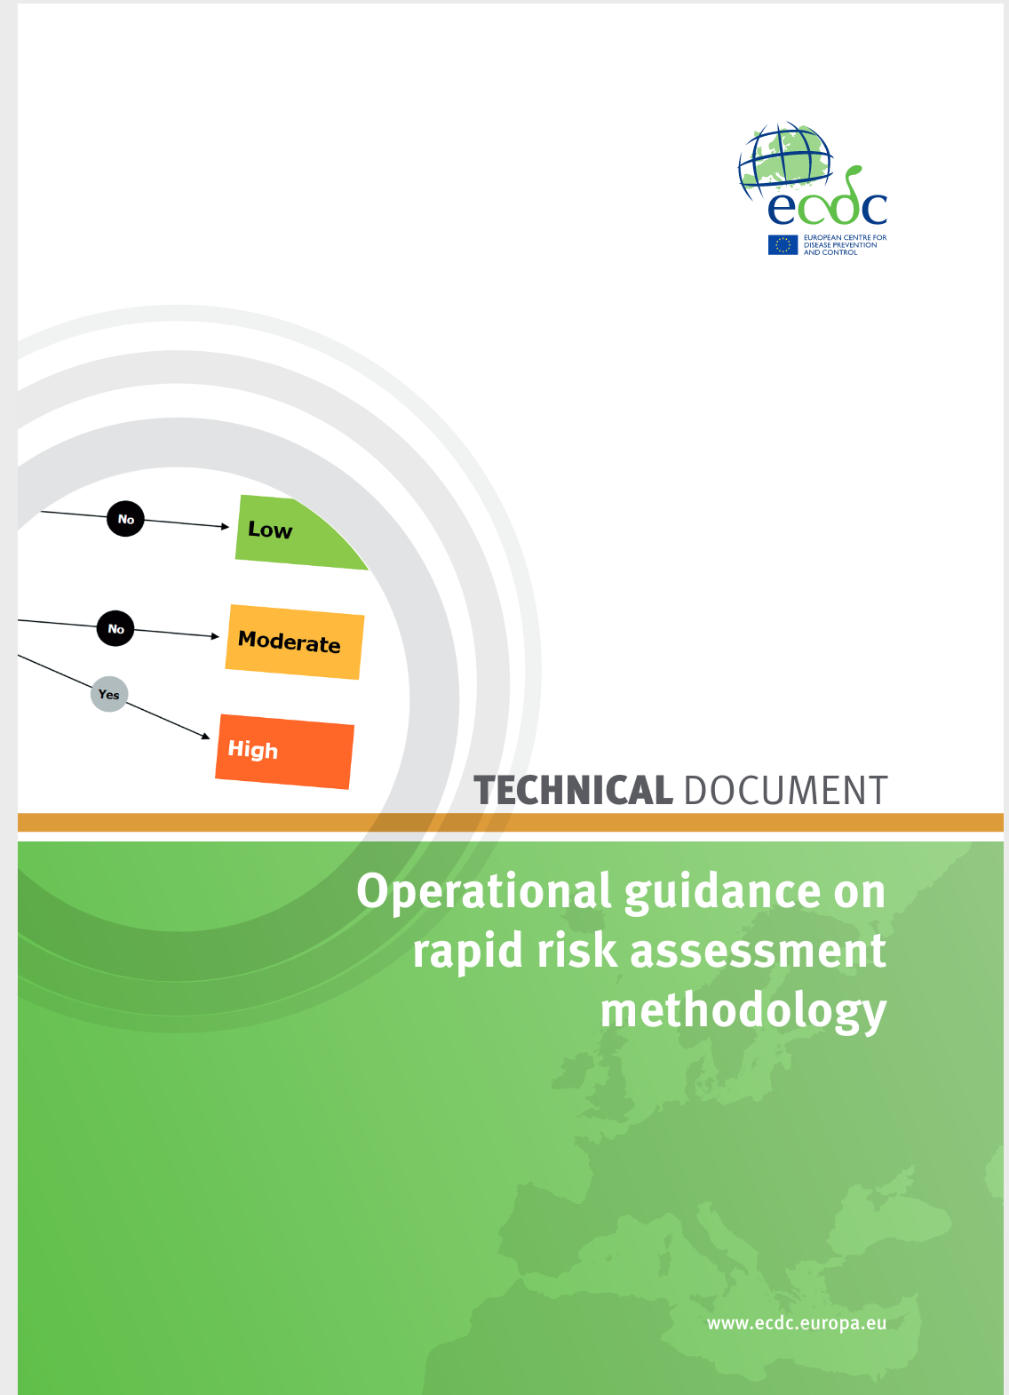
Introduction
Risk analysis
+ Complex
+ Information
+Cost
+Flexibility
Qualitative
Quantitative
Deterministic
Stochastic
RRA is not a replacement for a thorough formal Risk assessment
Notes:
El análisis de riesgo generalmente se divide en cualitativo y cuantitativo, y el análisis cuantitativo puede ser determinístico o estoastico
Generalmente, mientras mas bajamos en esta grafica pues nuestro análisis se vuelve mas complejo, requiere mas información, personal entrenado y generalmente software, puede ser mas costoso, pero es mas flexible y puede ser mas solido al momento de apoyar la toma de decisiones.
Existen varias guias para apoyarnos en el análisis de riesgo cuantitativo o cualitativo. Son muy detalladas y marcan la pauta de como debe de ser un análisis solido, pero pues el análisis finalmente se tiene que hacer en otros softwares computacionales

Slide 5
Steps
Disease Intelligence
Triage
Establishing a team
Uncertainty Analysis
Hazard profile
Risk pathways
Formulation of question
Data collection
Expert opinion
RRA performed
Reporting
Notes:
The process of a RRA can be described as a series of sequential steps that includes:
Triage, which is when we perform the initial evaluation of the risk event to indicate whether or not requires a RRA
Establishing a team, constitution of a team that will anticipate in the planning of the scenarios, data collection, expert opinion, and communication of the results
Hazard profile, Which is when we do a concise description of the event, the context, current state of knowledge and risk management options
Formulation of questions, we define specific questions to be answered during the RRA
Data collection
Expert opinion (if needed)
Performing the RRA, process of assessing the risk
Reporting, which includes the preparation and presentation of the results.
In addition to this, other activities must be performed before and during the process:
Disease intelligence, Which is the systematic collection, analysis and communication of data and information for detecting, verifying, assessing and investigating events and levels of risk in order to inform the design and implementation of a response.
Identification of risk pathways, a graphical representation of the logical pathways by which the hazard might be introduced.
Uncertainty assessment, The process of identifying and characterizing areas of uncertainty related to the input data and variables collected during the risk assessment process and how those affect the structure of the assessment
RRA is an iterative process, so when new data or information become available, the outputs of the steps in the RRA can be reviewed and revised. Periodic reviews of RRA are also recommended when the epidemiological situation changes or new mitigation strategies are applied.

Slide 6
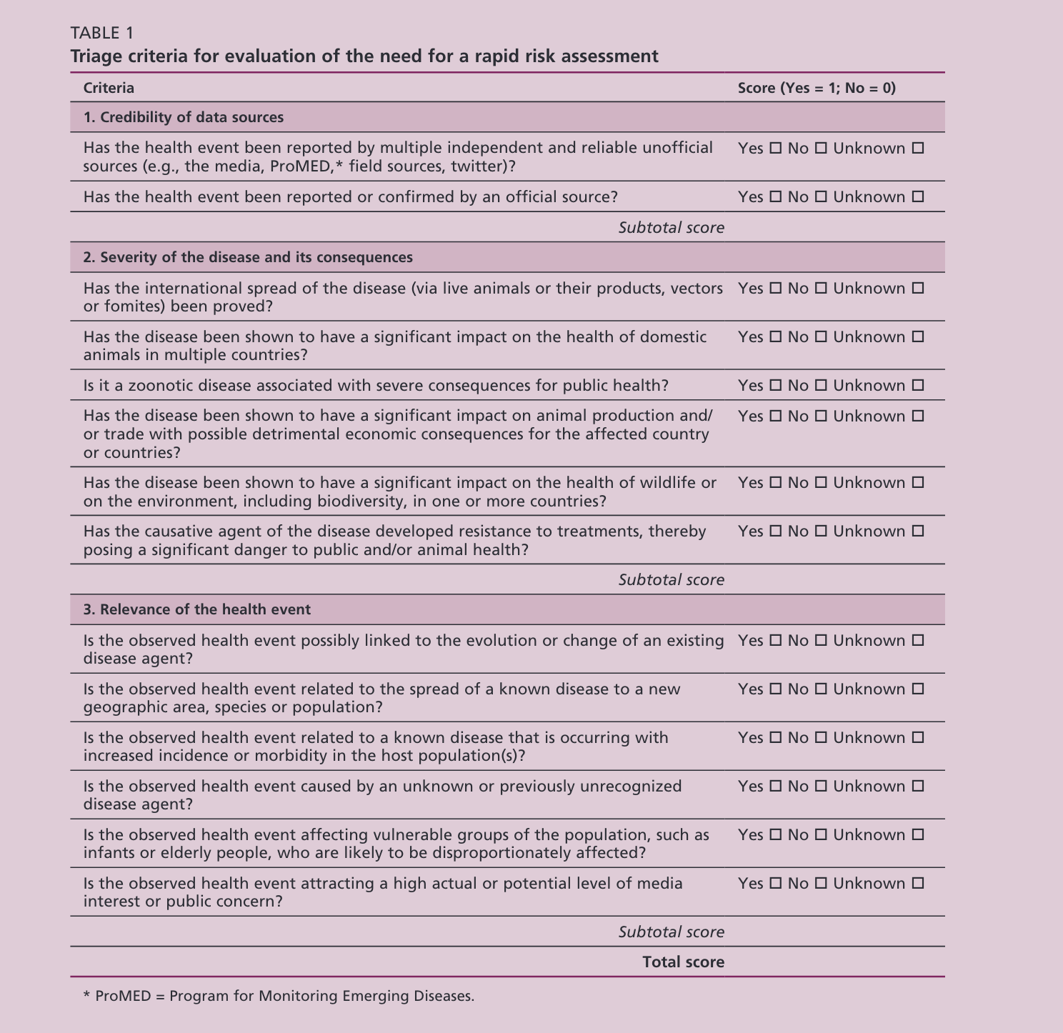
1: Triage
Credibility
Results of the triage might include:
No need for further action
More information needed
Need for a RRA
Severity
Relevance
Notes:
A standardized approach must be used to determine the need of a RRA, such standardization can be achieved trough he use of algorithms based on specific criteria.
In this example, there is a series of questions with a score is assigned for yes/no. A threshold value for triggering a risk assessment has to be set and the sum of scores are compared to that threshold.
Based on the information available, the triage process focuses on:
Credibility of the information
Severity of the disease consequences
Relevance of the event related to the animal, environmental or human health and the economic impact
Results of the triage might include:
No need for further action (when the score is below the set threshold)
More information needed (when we have many unknowns)
Need for a RRA (If the score is greater than the threshold set)

Slide 7






2: Establishing a team
Notes:
2: Team
Ideally we would like to have a multidisciplinary team of people with different areas of expertise such as veterinarians, epidemiologists, health economists, statisticians

Slide 8
3: Hazard profiling
A description of the health event and its context, current state of knowledge and potential risk management options
Classification of the causative agent
Persistence in the environment
Pathogenesis
Epidemiology
Diagnosis
Prevention and control
Impact
Notes:
A hazard profile is description of a health event and its contexts, the current state of knowledge and potential risk management strategies.
The hazard profile applies to the specific context in which the risk assessment will be conducted; draws on data that are related only to the health event concerned; and provides basic information for conducting the RRA

Slide 9
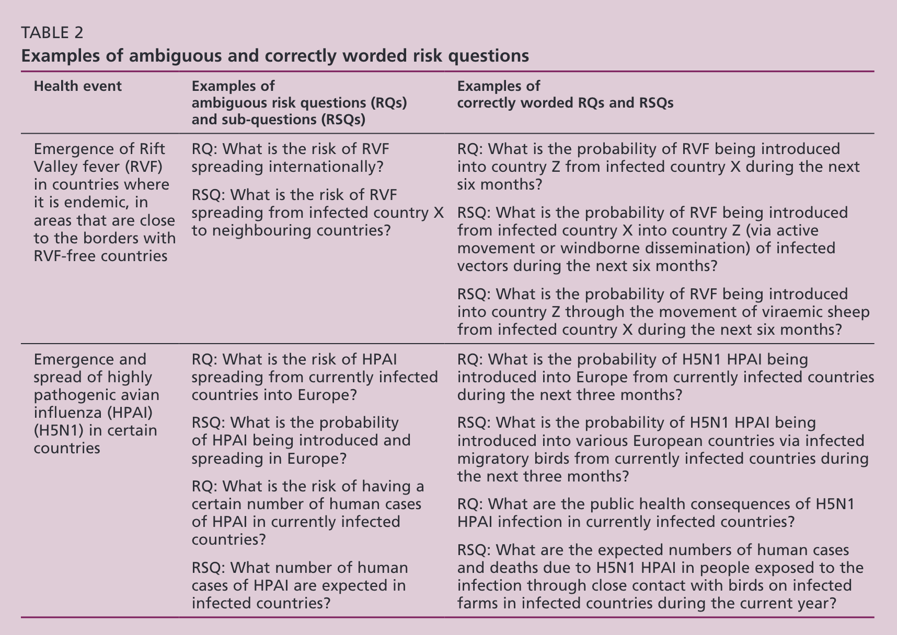
4: Formulation of questions
What
Where
When
How
Notes:
Risk questions must be as detailed as possible for the context of the risk event, and should be split in specific sub-questions.
Here is an example of health events and some ambiguous questions
Sub-questions must be precise and should cover four main dimensions of risk:

Slide 10
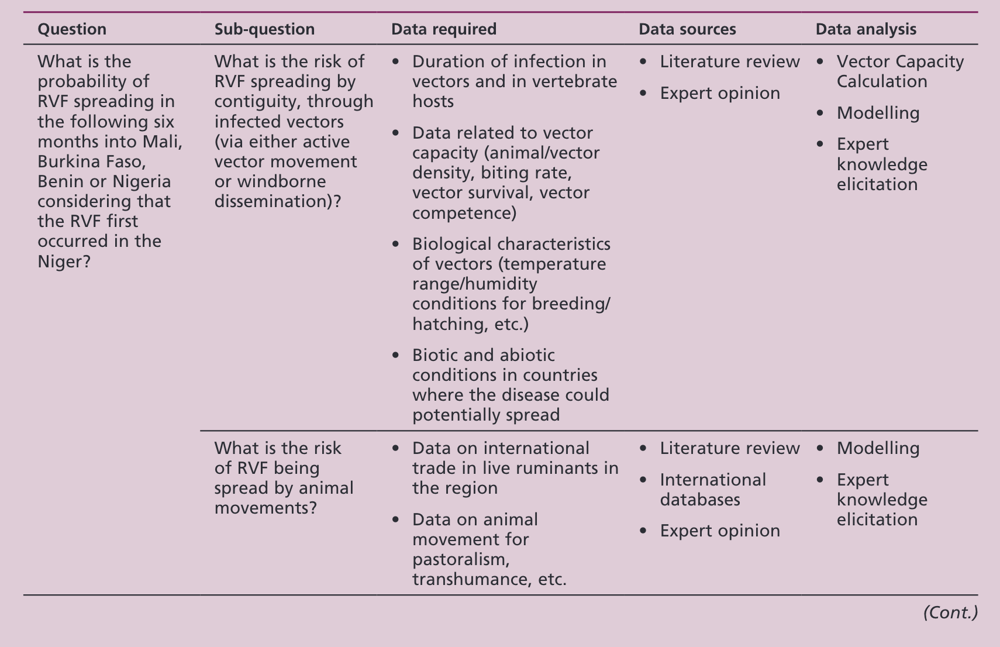
4: Formulation of questions
Notes:
Once the questions have been formulated, the available data, evidence and possible sources of information for each question and sub-question must be listed.
It is also useful to identify and list the possible approaches for the analysis and related methods to use during the assessment

Slide 11




5: Data collection
To facilitate the search for data, eligibility criteria should be defined that take into account:
Animal population of interest
Variables of concern
Possible geographical and time restrictions
Notes:
Data collection for supporting risk assessment is usually time consuming, costly, and resource-intensive; which often represent the main constraint to the timely production of robust RRAs
To facilitate the search for data, eligibility criteria should be defined that take into account:
Animal population of interest
Variables of concern
Possible geographical and time restrictions
A clear definition of risk pathways and formulation of questions is essential to accelerate the process and identify most relevant information needed

Slide 12

6: Expert opinion
Expert knowledge elicitation methods include:
Sheffield protocol
Cooke’s method
Delphi method
Online questionnaire
Expert panel
Interviews
Focus groups discussions
Notes:
When there are gaps in the required information and data, expert opinion is esscential for providing the necessary inputs and validation.
Options can include: ….
Depending on the time available, expert knowledge elicitation (EKE) can be carried out using the systematic methodologies. EKE aims to reduce the subjectivity trough consensus or mathematical aggregation of expert estimates
Expert knowledge elicitation methods include:
Sheffield protocol, experts interact with each other during face-to-face meetings or elicitation workshops during which they discuss and exchange opinions about the questions concerned under supervision of the elicitor
Cooke’s method, a questionnaire is applied to a group of experts and it is NOT allowed interaction or discussion between the experts. Weighted aggregation of experts estimations is carried out
Delphi method, these method shares similarities with the previous ones. Repeated rounds of discussion are managed by the elicitor over a period of time and judgments for each round are returned to the experts in the subsequent round anonymously. Final estimations are obtained via simple, equal weighted, mathematical aggregation

Slide 13
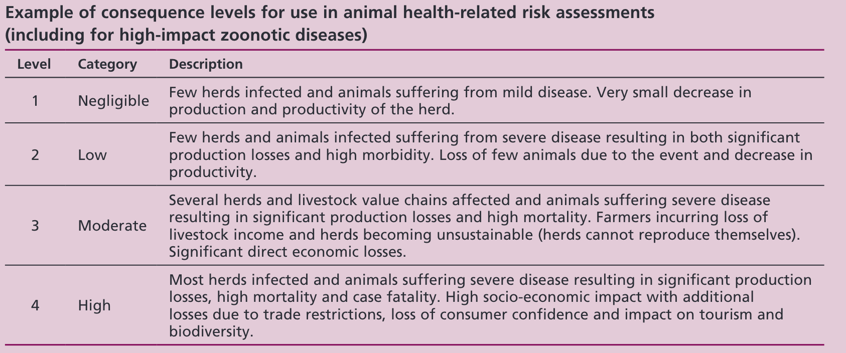
7: Performing the assessment
Type of outputs might include:
Probability
Probability of X event happening
Probability of more than 10 introductions per year
Consequences
Number of animals/people infected
Economic impact
High
?
Low
Level of risk
Notes:
Depending on the methodology used and the specific purpose, the outputs can vary considerably
Probability estimates
Consequences
Qualitative approaches are usually easier for decision makers to understand, one must be very clear with the criteria used. The criteria for the risk categories used must be clearly predefined.
fin

Slide 14
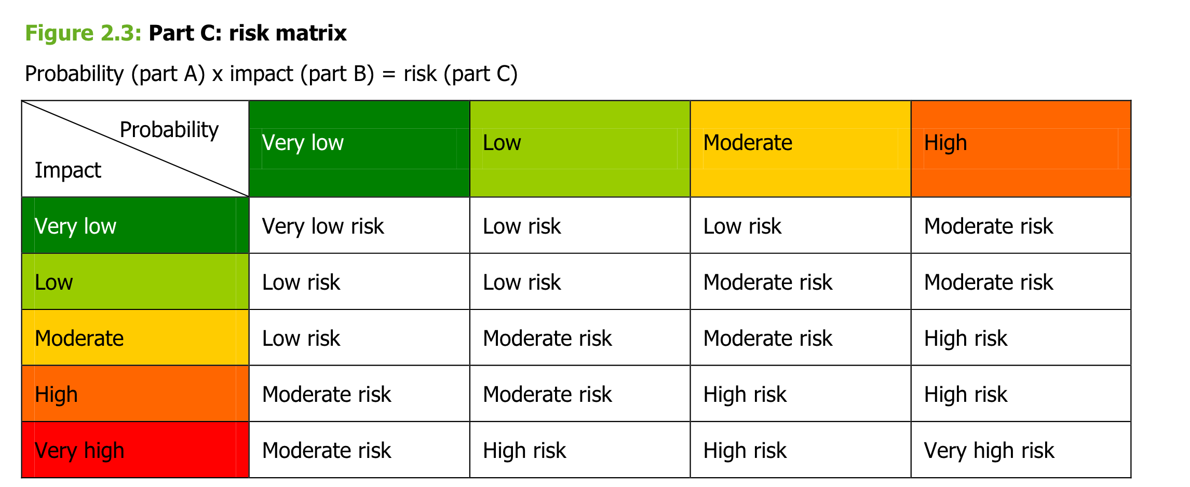
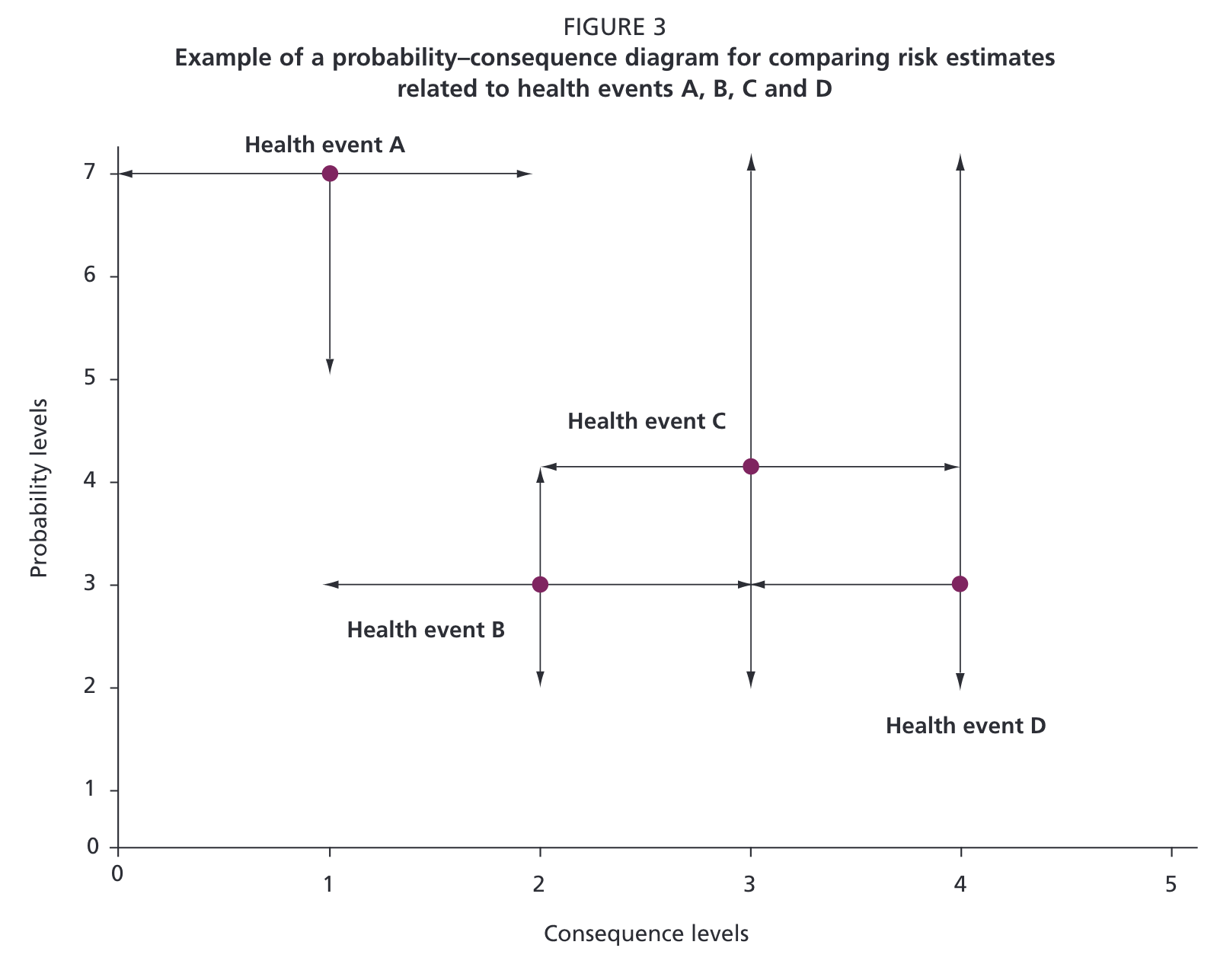
7: Performing the assessment

Slide 15

8: Report
Target audience?
Risk managers
General public
Scientific community

Slide 16
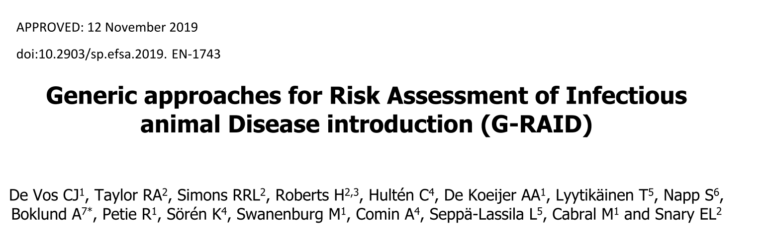
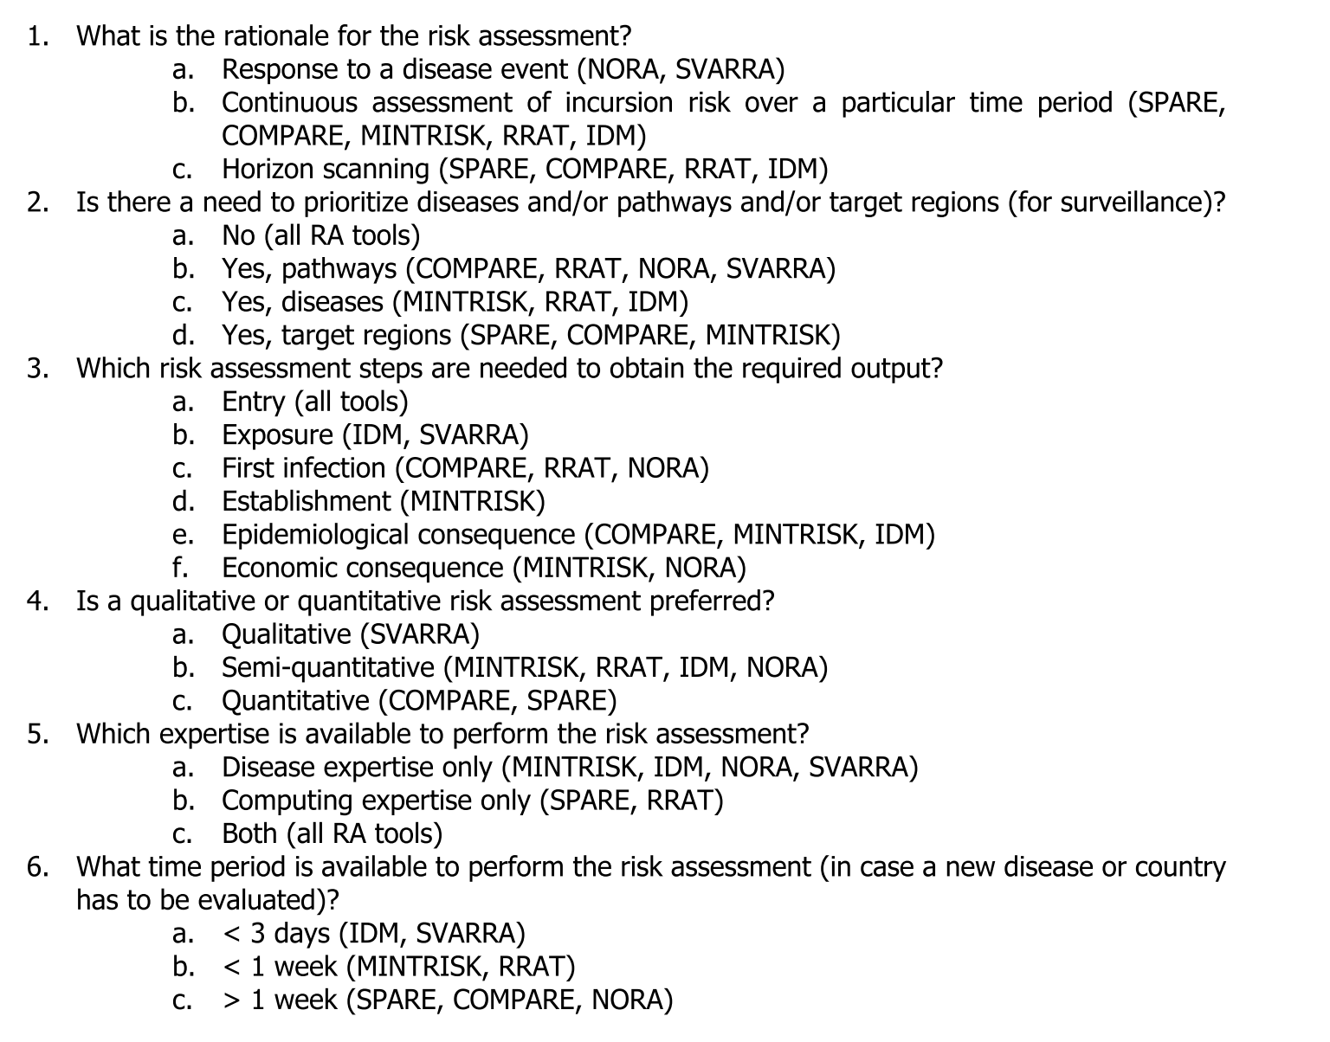
Some examples
SVARRA
MINTRISK
RRAT
IDM
NORA
SPARE
COMPARE
Qualitative
Semi-quantitative
Quantitative
Notes:
In 2019 De Vos and coauthors compared multiple tools to perform RRA, some of the tools included in this review w
EN el 2019 salió este paper, que hace un muy buen trabajo comparando varias herramientas genéricas para el análisis de riesgo y resumiendo las opciones disponibles que existen actualmente en introducción de enfermedades.
Las herramientas que se compararon fueron estas, entre las cuales hay algunas cualitativas, semicuantitativas y cuantitativas
Estos fueron algunos de los criterios para comparar las herramientas y a mi el que mas me llamo la atencion fue el ultimo, que pregunta que tanto tiempo toma realizar el analisis. y pues vemos que para las herramientas cuanitativas generalmente toma mas de una semana . suponinedo que nos toma 2 semanas, no deja de ser un periodo de tiempo rapido para un analisis, pero pues esto puede variar mucho dependiendo de los recursos y personal que tengamos.
Justamente la guia de FAO para anlisis de riego rapido recalca lque los analisis de riesgo rapidos son criticos para situaciones de emergencia, y no reemplaza hacer un analisis de riesgo detallado con mastiempo y mas informacion, pero puede marcar una diferencia para situaciones de emergencia

Slide 17
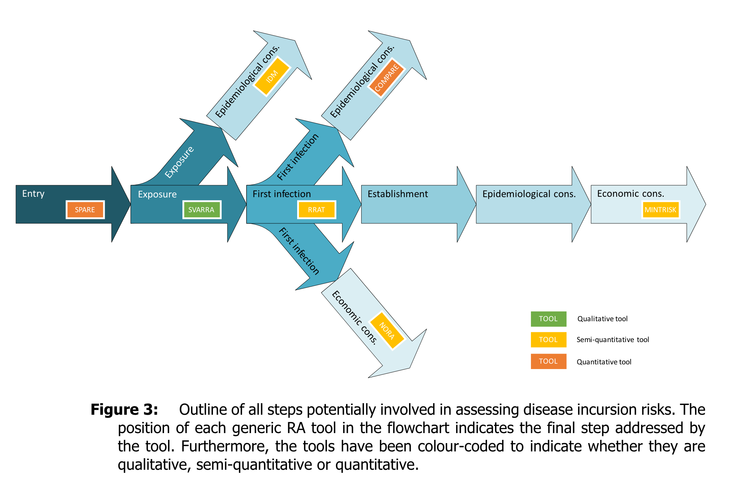
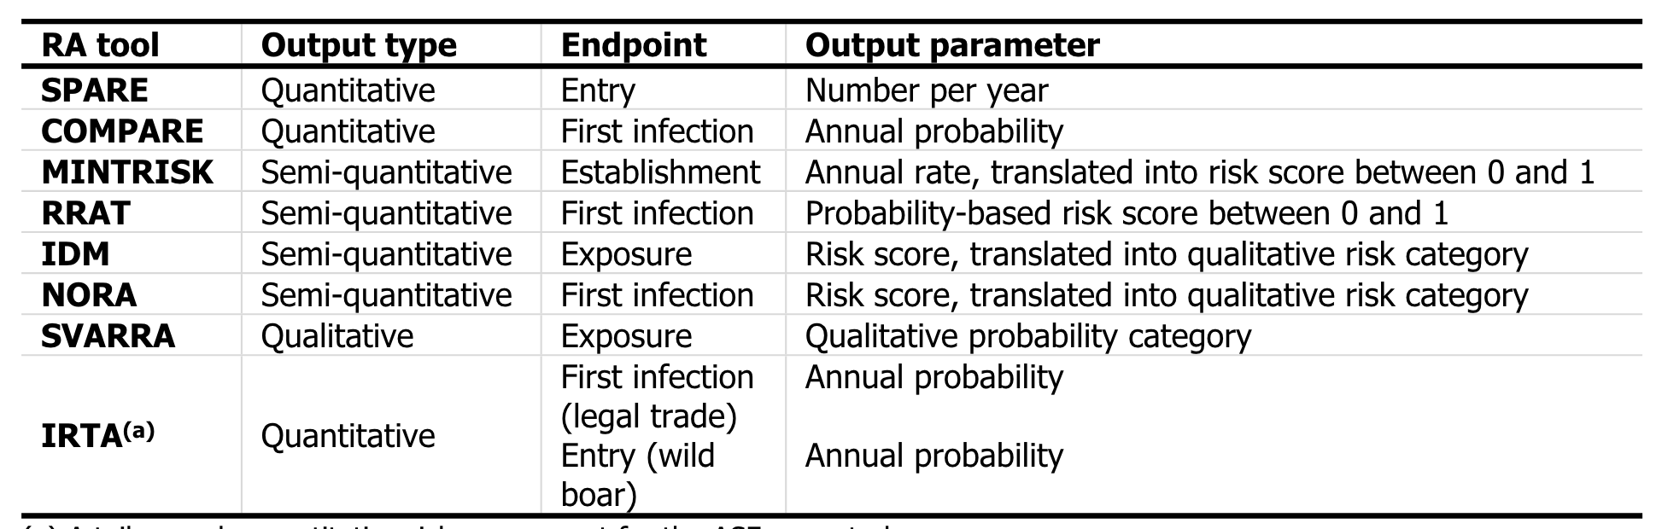
Some examples
Notes:
In 2019 De Vos and coauthors compared multiple tools to perform RRA, some of the tools included in this review w
EN el 2019 salió este paper, que hace un muy buen trabajo comparando varias herramientas genéricas para el análisis de riesgo y resumiendo las opciones disponibles que existen actualmente en introducción de enfermedades.
Las herramientas que se compararon fueron estas, entre las cuales hay algunas cualitativas, semicuantitativas y cuantitativas
Estos fueron algunos de los criterios para comparar las herramientas y a mi el que mas me llamo la atencion fue el ultimo, que pregunta que tanto tiempo toma realizar el analisis. y pues vemos que para las herramientas cuanitativas generalmente toma mas de una semana . suponinedo que nos toma 2 semanas, no deja de ser un periodo de tiempo rapido para un analisis, pero pues esto puede variar mucho dependiendo de los recursos y personal que tengamos.
Justamente la guia de FAO para anlisis de riego rapido recalca lque los analisis de riesgo rapidos son criticos para situaciones de emergencia, y no reemplaza hacer un analisis de riesgo detallado con mastiempo y mas informacion, pero puede marcar una diferencia para situaciones de emergencia

Slide 18
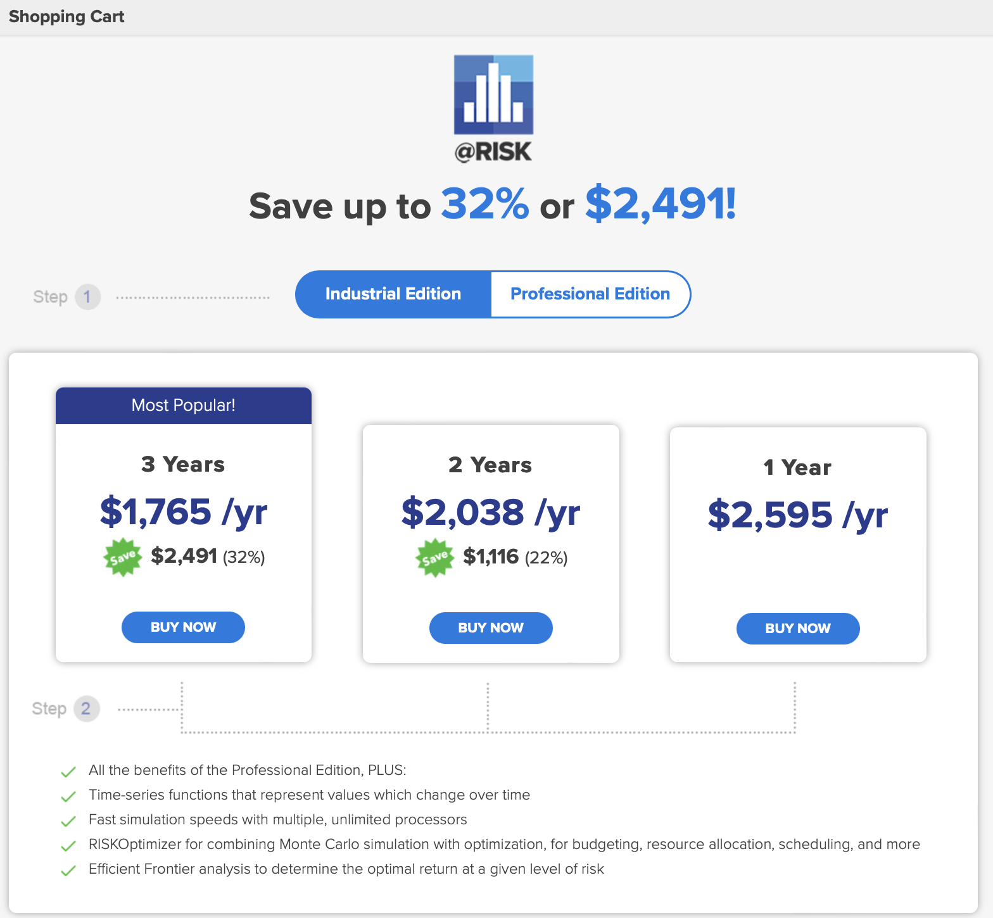

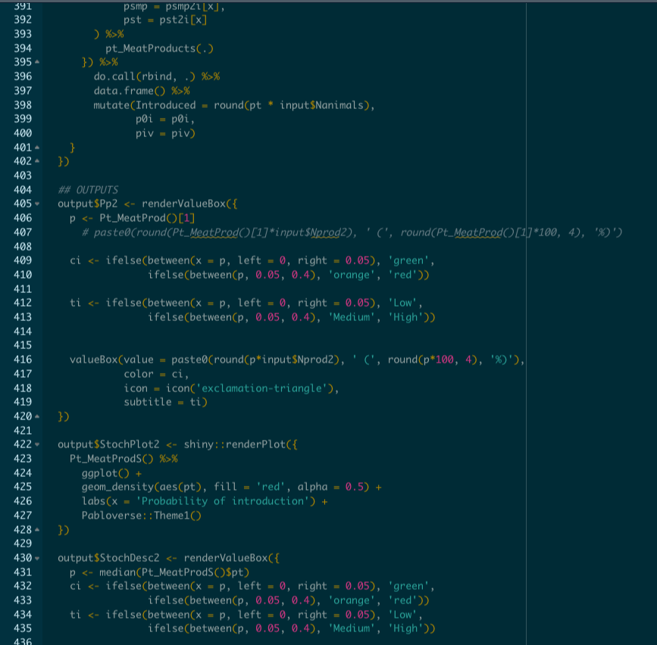

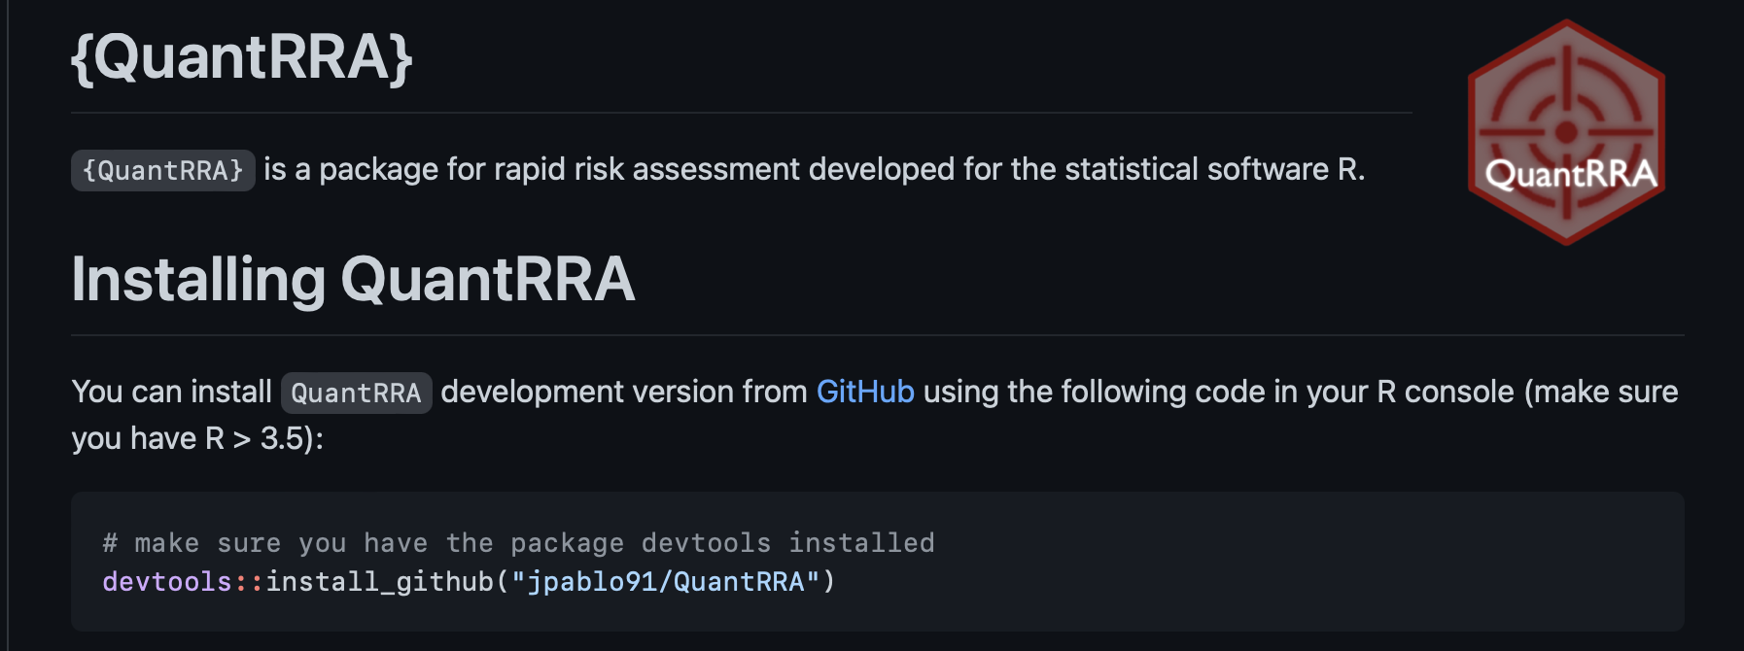
How to do the actual assessment?
Notes:
We can of course use @risk to do this, which we have been doing over the last couple of weeks, but for those of you that will not be lucky enough to have access to the software after this class, we wanted to provide other options, which usually are a little bit less straight forward and involves some coding.

Slide 19
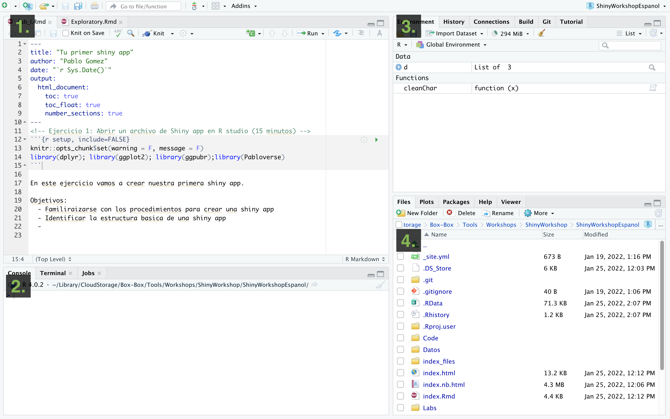

Intro to Rstudio

Slide 20
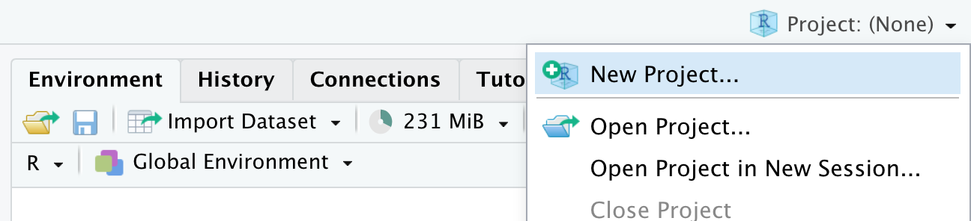
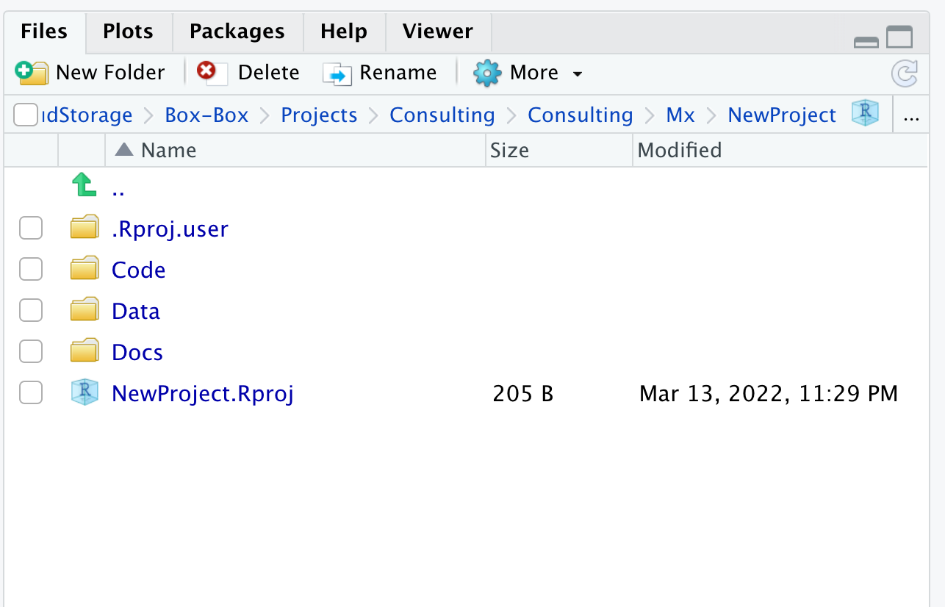
Intro to Rstudio

Slide 21
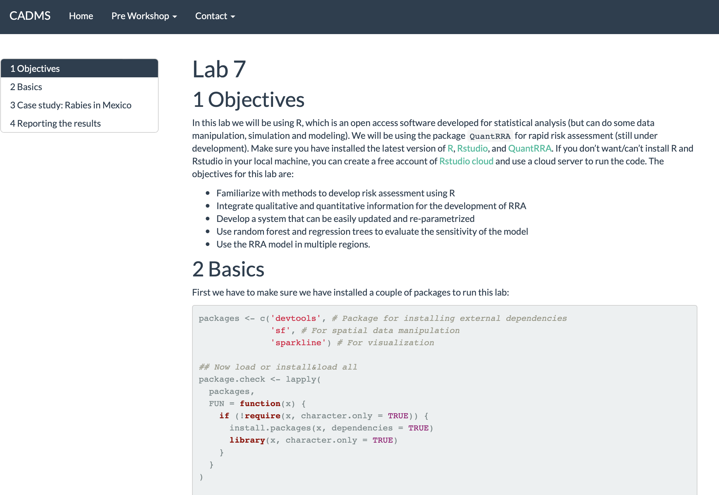
Lab

Slide 22
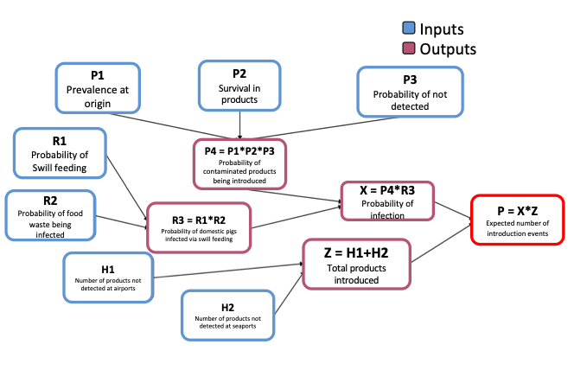
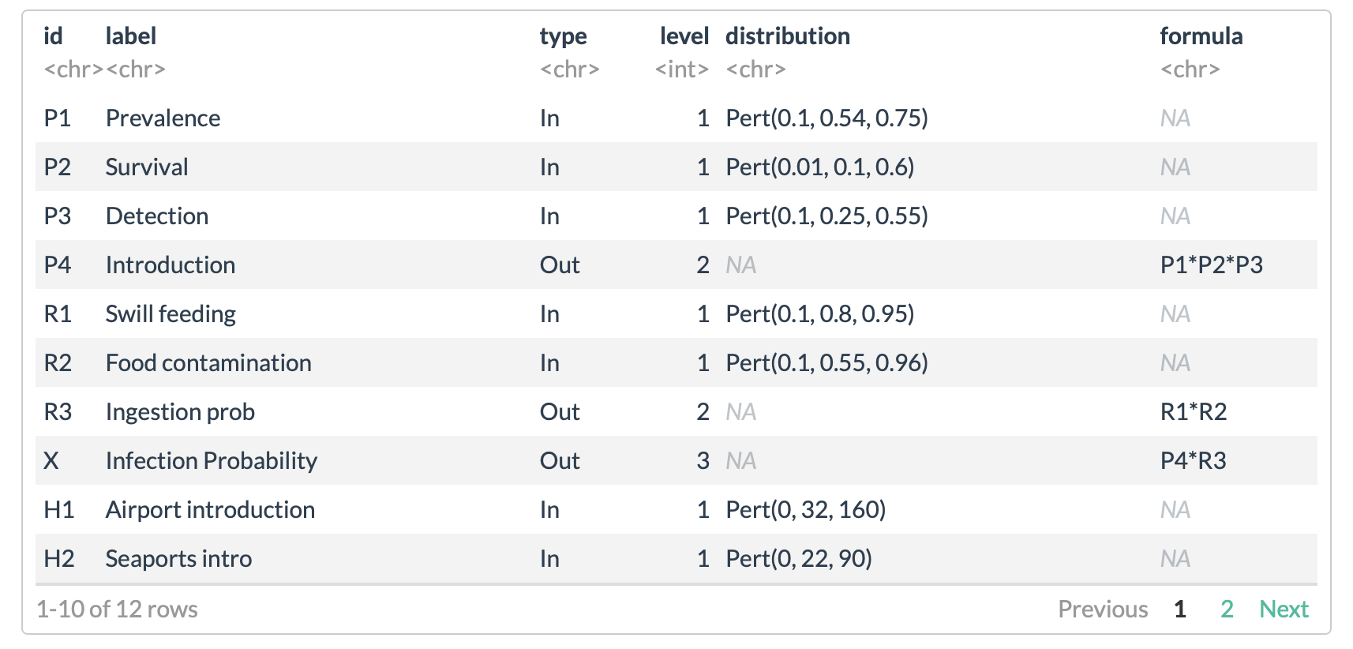
Lab

Slide 23
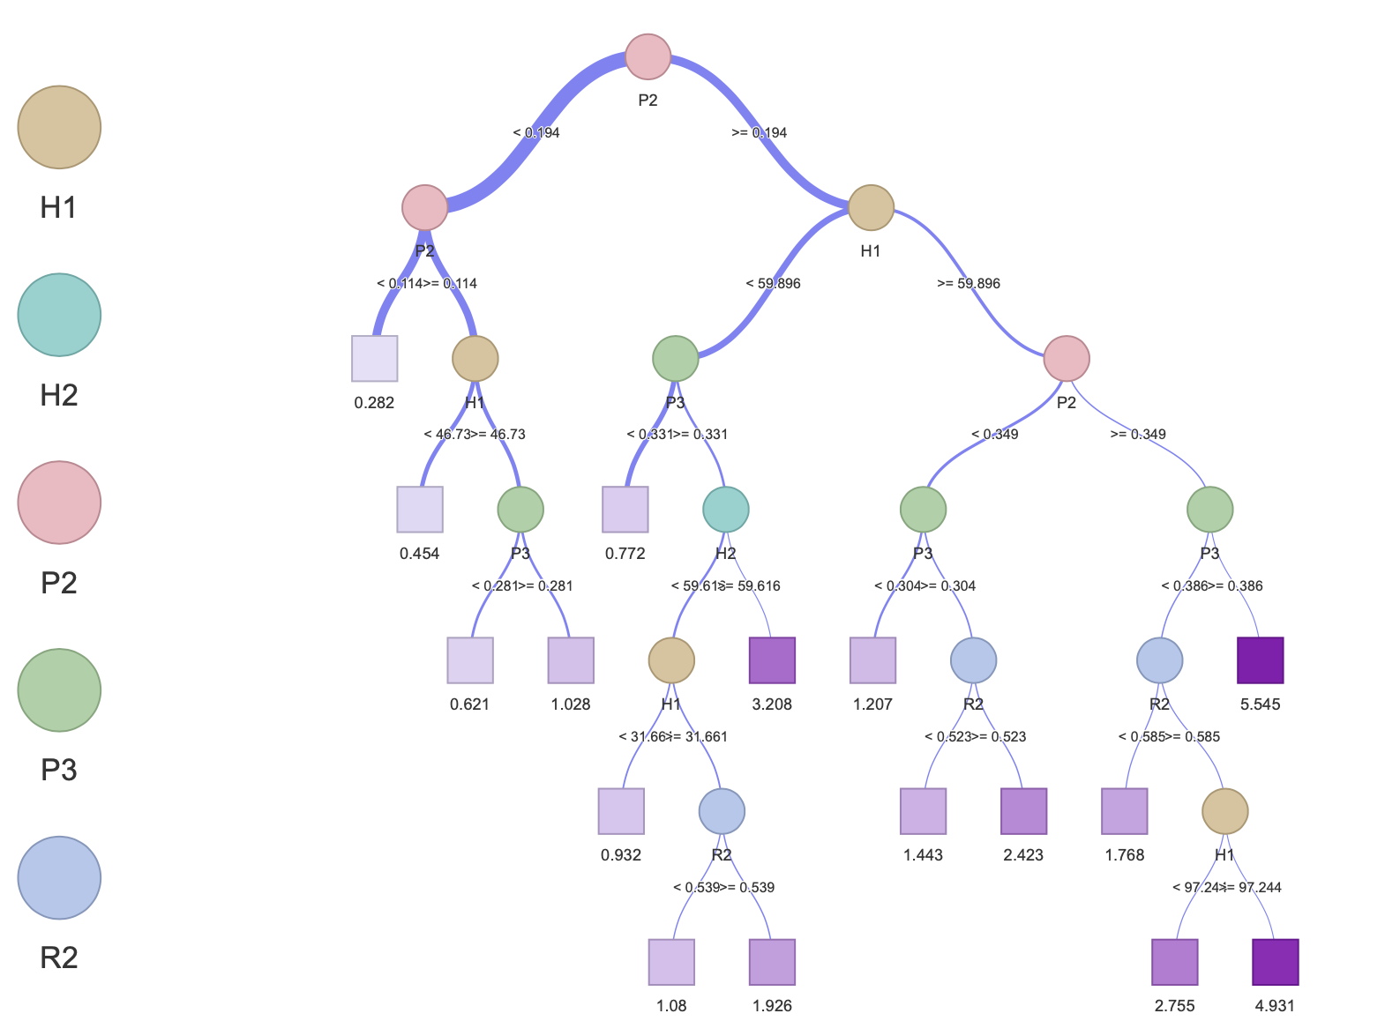
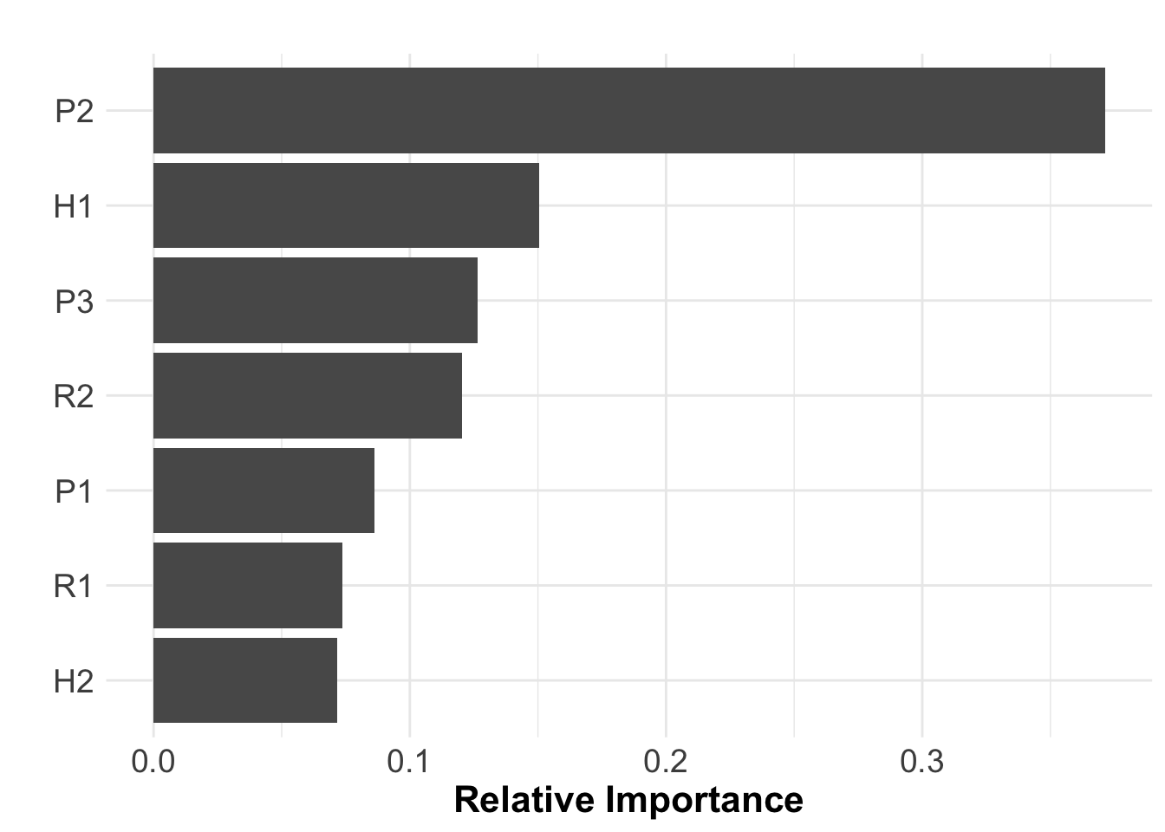
Sensitivity analysis
Notes:
Clasification and regression trees, and RF,. Which are relatively simple non-parametric models to build. RF provide us to the variance explained by our model, as well as the relative importance of the variables in the model outcomes.
With CART we can have a visual representation of how the interactions between the parameters result into different outcomes

Slide 24
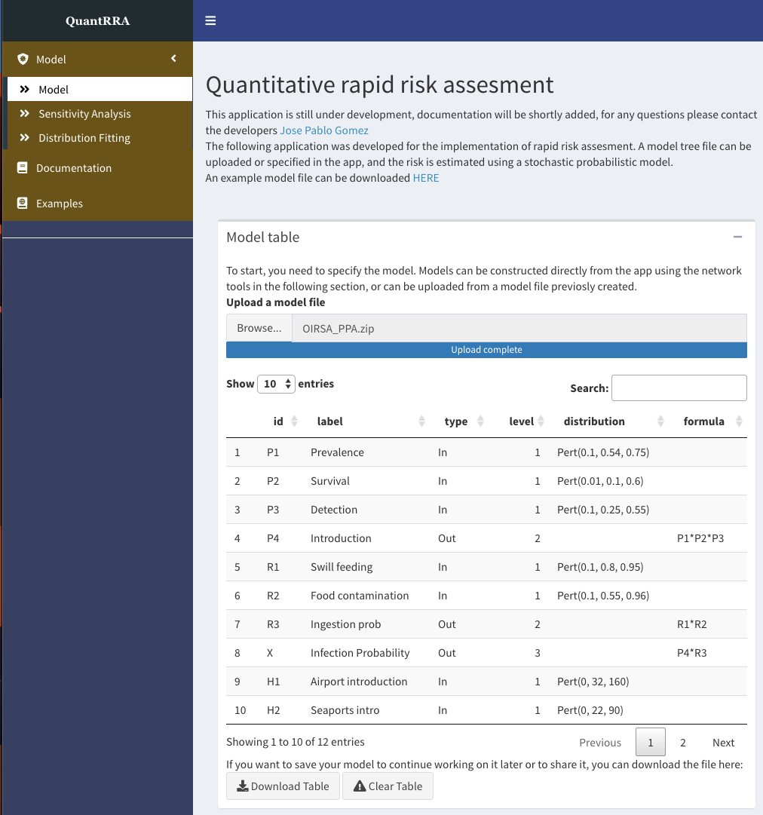
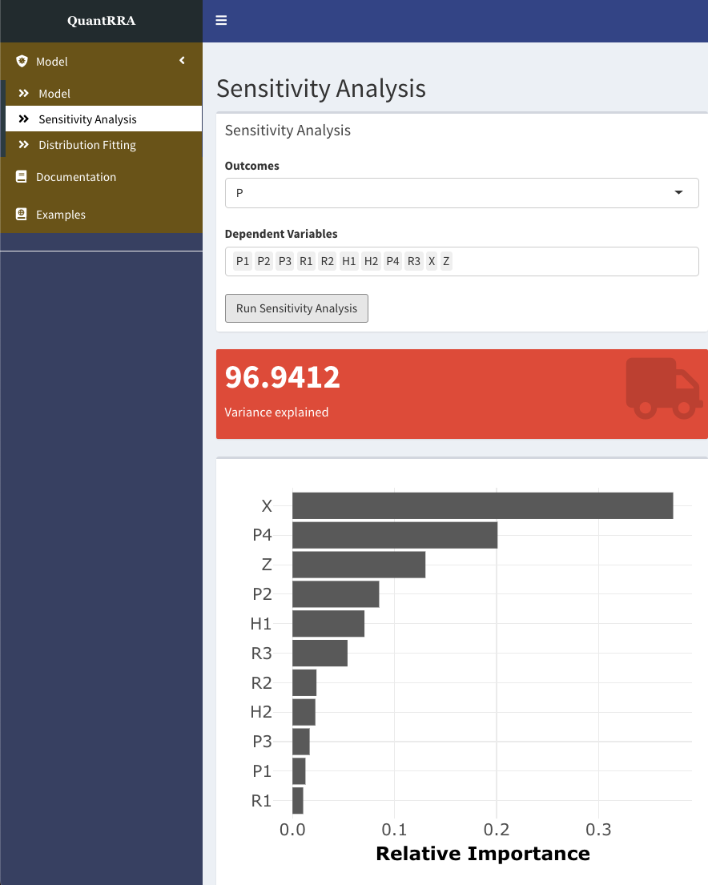
Interactive version
Notes:
Clasification and regression trees, and RF,. Which are relatively simple non-parametric models to build. RF provide us to the variance explained by our model, as well as the relative importance of the variables in the model outcomes.
With CART we can have a visual representation of how the interactions between the parameters result into different outcomes

Slide 25
Questions?
Contact: jpgo@ucdavis.edu
Website: http://spablo-temporal.network/
Notes:
Clasification and regression trees, and RF,. Which are relatively simple non-parametric models to build. RF provide us to the variance explained by our model, as well as the relative importance of the variables in the model outcomes.
With CART we can have a visual representation of how the interactions between the parameters result into different outcomes

Slide 26
Human pop
Dog pop
Contact Probability
No transmission
N bites
Aggression probability
No transmission
People
Vac
Infected probability
No transmission
Wildlife
contact
Transmission probability
Transmission

Slide 27
I1
Human population
O1
Human-Dog contact
No
No transmission
I2
Dogs population
Yes
I3
Reported bites
O2
Bite aggression
No
No transmission
Yes
I4
Vaccination Coverage
O3
Dog being infected with rabies
No
No transmission
I5
Estimated Prevalence
Yes
I6
Probability of effective transmission
O4
Dog-Human rabies transmission
Inputs
Outputs

